Slide 1
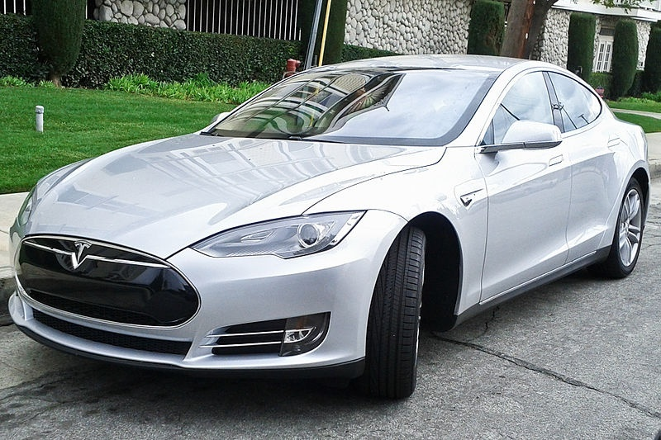
Add your logos here, in the master slides (masque de diapositives) so it will appear on each slide
Title of Your Oral Presentation as It Appears on the PDF
L.BAGHLI ¹, B. CHERKI ¹, M. DJEMAI ²
¹ LAT, Laboratoire d'Automatique de Tlemcen, Université de Tlemcen, Algeria
(lotfi.baghli@green.uhp-nancy.fr)
² Univ. Lille Nord de France,F- 59000 Lille, France, UVHC, LAMIH, F-59313 Valenciennes, France,
CNRS, UMR 8201, F-59313 Valenciennes, France
Give the authors name and affiliation

Slide 2
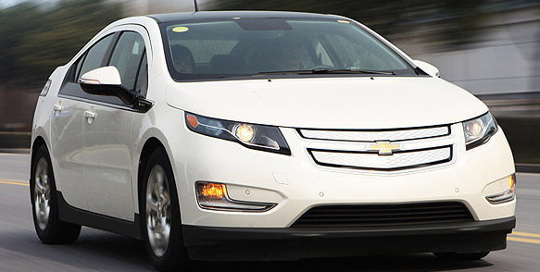
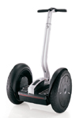
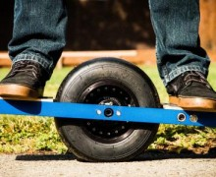
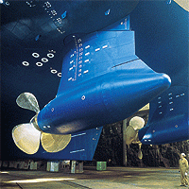
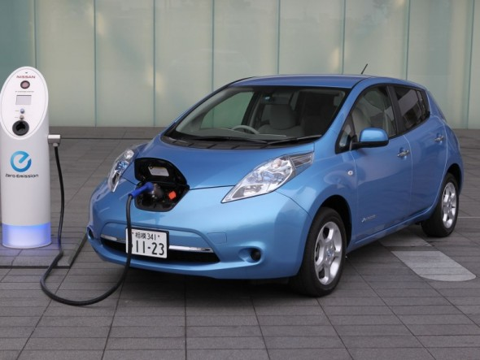
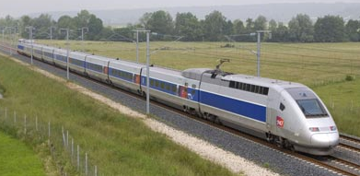
Plan
Keep the plan simple
Introduction
Questions / Solutions
Technologies
Conclusions and perspectives

Slide 3
Modifiy your name, in the master slides (masque de diapositives)

Slide 4
Thank you for
your attention
Discussion

Slide 5
Some tips for your presentation
You have 12 min of presentation
+ 3 min for questions
So no more than 15 slides

Slide 6
The curves must be readable, white background is preferable
Processing data (suburban track)
MAF and motor speed versus distance

Slide 7
Do not put too much text, you should speak and not read the text
Introduction
Transport:
  A societal objective
  Must be achieved daily
Distance working (ICT, distance learning,…)
Human contact:
  Trading, attending school, holiday, shopping
Activities that are transport-energy consuming

Slide 8
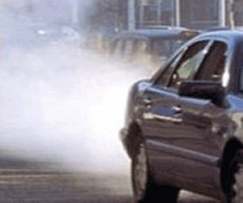
Do not put too much text, you should speak and not read the text
You can use photos also
Cons of transport
Urban air pollution
Oil dependency
Crowded city centers
Climate change

Slide 9
Energy consumption of transport, by mode
1 000 tonnes of oil equivalent
If you take information from the web or author, give the reference (http or DOI)
http://epp.eurostat.ec.europa.eu/portal/page/portal/sdi/indicators/theme7
Notes:
This indicator covers the consumption of energy in all modes of transport, with the exception of maritime and pipelines.

Slide 10
Use bright colors,
avoid the green and the brown,
use big fonts
Power and Battery
Power Grid
Power Grid
Battery
Battery
Fuel
Battery
Fuel
EV
HEV
PHEV
Fuel cells: not enough powerful
Supercapacitor: dampers

Slide 11
Bitmaps must be used with the highest resolution
Use color in the text according to the graphics
Toyota Prius
Ch1 MG1 line voltage,
Ch2 MG1 line to line voltage,
Ch3 MG1 current,
Ch4 MG2 current
MG1 in generator mode, Toyota Prius is cruising

Slide 12
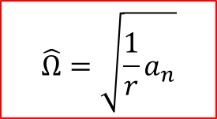
Accelerometer MEMS
Torque and speed versus time in transient
Use the Equation editor to write clean scalable equations (red), avoid scanned or bitmap equations
$$\hat{Ω}=\sqrt{\frac{1}{r}a_{n}}$$

Slide 13
Conclusions and perspectives
Tracking of vehicle position and engine data
Use OBD-II standard that suits most vehicles
Lack of altitude precision
Process energy, forces
Optimal control laws
Sizing of equivalent EV motorization and batteries
Test on buses
Make it simple and readable

