Slide 1


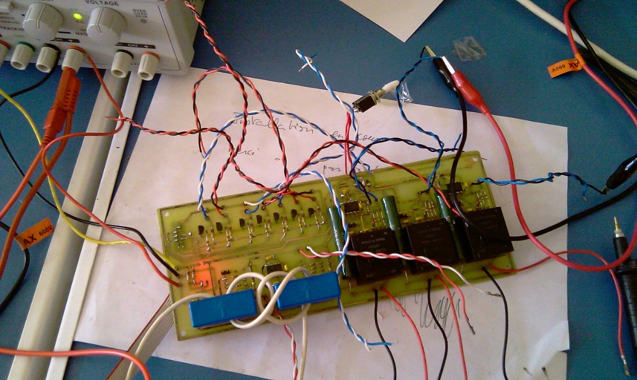
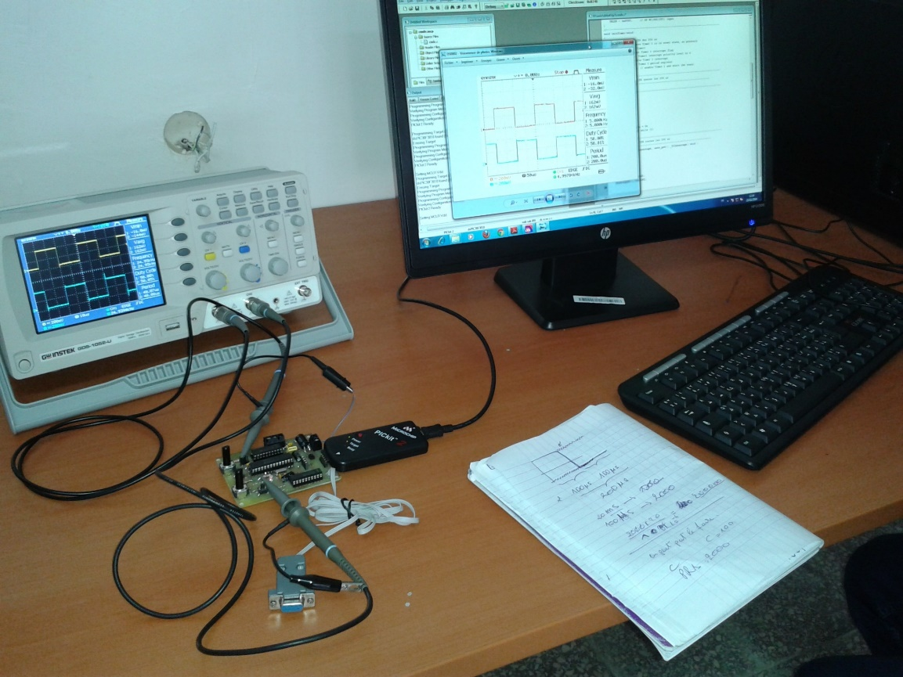
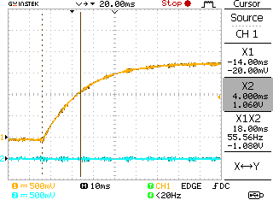
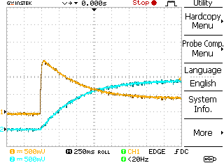
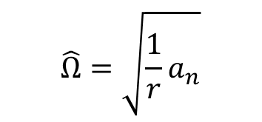
Add your logos here
ID 4375
Title of Your Poster Presentation as It Appears on the PDF
Put the Paper ID on the Top Right of your Poster
L.BAGHLI ¹, B. CHERKI ¹, M. DJEMAI ²
¹ LAT, Laboratoire d'Automatique de Tlemcen, Université de Tlemcen, Algeria
(lotfi.baghli@green.uhp-nancy.fr)
² Univ. Lille Nord de France,F- 59000 Lille, France, UVHC, LAMIH, F-59313 Valenciennes, France,
CNRS, UMR 8201, F-59313 Valenciennes, France
Cons of transport
Urban air pollution
Oil dependency
Crowded city centers
Climate change
Examples of Text, figures, equations (no bitmap)
Pay attention to the size which must be readable from far enough
Do not put too much text
$$\hat{Ω}=\sqrt{\frac{1}{r}a_{n}}$$
Position control with a FOC of Induction Motor
Current and voltage measure board
Experimental bench
Position control
MAF and motor speed versus distance
Speed control
Voltage step at locked rotor
Current response
Voltage step
Current and speed transients
Conclusions and perspectives
Current control
Tracking of vehicle position and engine data
Use OBD-II standard that suits most vehicles
Lack of altitude precision
Process energy, forces
Optimal control laws
Sizing of equivalent EV motorization and batteries
Test on buses

